Slide 1
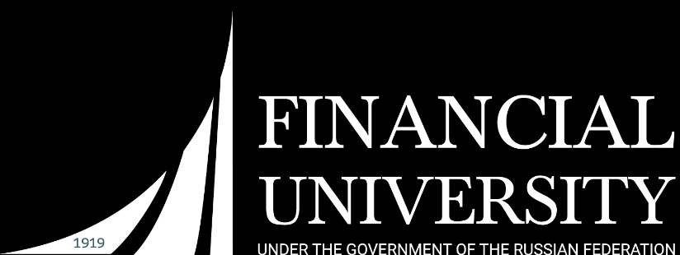

Virtual reality
Zavaruev Ivan
Shiryaeva Yulia
PI19-1v

Slide 2
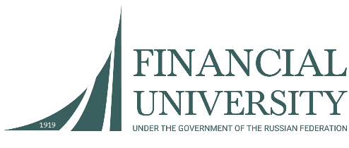


history
Advertising Expenditures Remain High
2010
year
+5.1%
growth

Slide 3

usage
Federal State Budget Institution of Higher Education " Financial University under the Government of the Russian Federation " (hereinafter the Financial University ) - one of the oldest Russian universities that train economists, financiers , lawyers on financial law , mathematicians , IT specialists , sociologists and political scientists .
Financial University - one of the leading universities of the country :
Financial University - one of the leading universities in the country that implements the 12 bachelor degree ( 28 Profile preparation ) , 11 areas of training of masters ( over 50 master's degree programs ) , 9 of the basic educational programs of secondary vocational education , as well as 10programm MVA and 108 retraining and professional development programs specialists.

Slide 4
education
Regional characteristics of the contingent enrolled at the 1st year undergraduate program at the place of permanent residence

Slide 5
modeling
Regional characteristics of the contingent enrolled at the 1st year undergraduate program at the place of permanent residence

Slide 6
gaming
Regional characteristics of the contingent enrolled at the 1st year undergraduate program at the place of permanent residence

Slide 7
Personal thoughts
Regional characteristics of the contingent enrolled at the 1st year undergraduate program at the place of permanent residence

Slide 8
future
Regional characteristics of the contingent enrolled at the 1st year undergraduate program at the place of permanent residence

Slide 9
thanks

